Slide 1

IFI 8420 Final Project Shreyashi Mukhopadhyay Telecom customer churn prediction: IBM Dataset

Slide 2
IFI 8420 Final Project Shreyashi Mukhopadhyay Telecom customer churn prediction: IBM Dataset

Slide 3
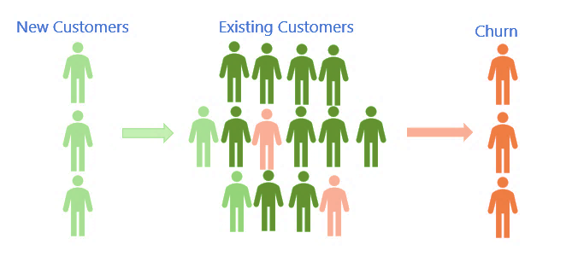
Business Question: Customer Churn Analysis
Companies invest a lot to acquire new customers.
When a customer leaves the company (churns), it is a loss of investment for the company.
Cost, time, and effort need to be invested to replace customers who have left the service.
Acquiring new customers is often more difficult and more expensive than retaining existing customers.
https://hbr.org/2014/10/the-value-of-keeping-the-right-customers

Slide 4


Data Source: Kaggle
The data has been sourced from Kaggle at: Telco customer churn: IBM dataset (kaggle.com)

Slide 5
Data Description
 | Null Count
Churn_Reason | 5174
Total_Charges | 11
CustomerID | 0
Count | 0
Country | 0
Zip_Code | 0
Lat_Long | 0
State | 0
City | 0
Gender | 0
Senior_Citizen | 0
Partner | 0
Dependents | 0
Tenure_Months | 0
Phone_Service | 0
Latitude | 0
Longitude | 0
Internet_Service | 0
Multiple_Lines | 0
Online_Security | 0
Online_Backup | 0
Streaming_TV | 0
Streaming_Movies | 0
Device_Protection | 0
Tech_Support | 0
Paperless_Billing | 0
Contract | 0
Monthly_Charges | 0
Payment_Method | 0
Churn_Label | 0
Churn_Value | 0
Churn_Score | 0
CLTV | 0
Number of rows: 7043
Number of columns: 33
Object: 24
Int64: 6
Float64: 3
The Churn Reason column has 5174 missing values because these customers have not churned.

Slide 6
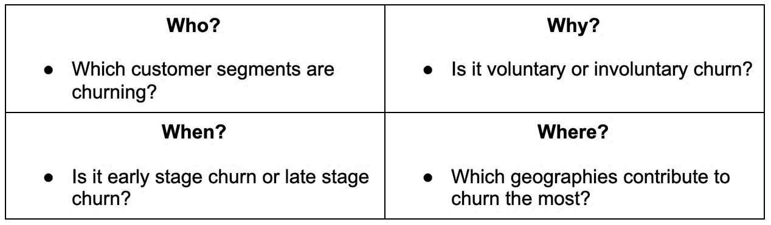
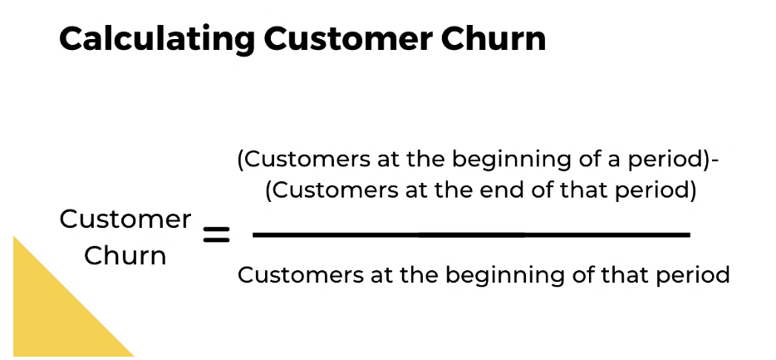
Churn rate calculation
Reasons:
- Inadequate service quality
- Network coverage or performance issues
- Billing process complications
- Better competitive offers
- Negative customer service experiences
https://www.chargebee.com/blog/reduce-customer-churn/

Slide 7
EDA

Slide 8
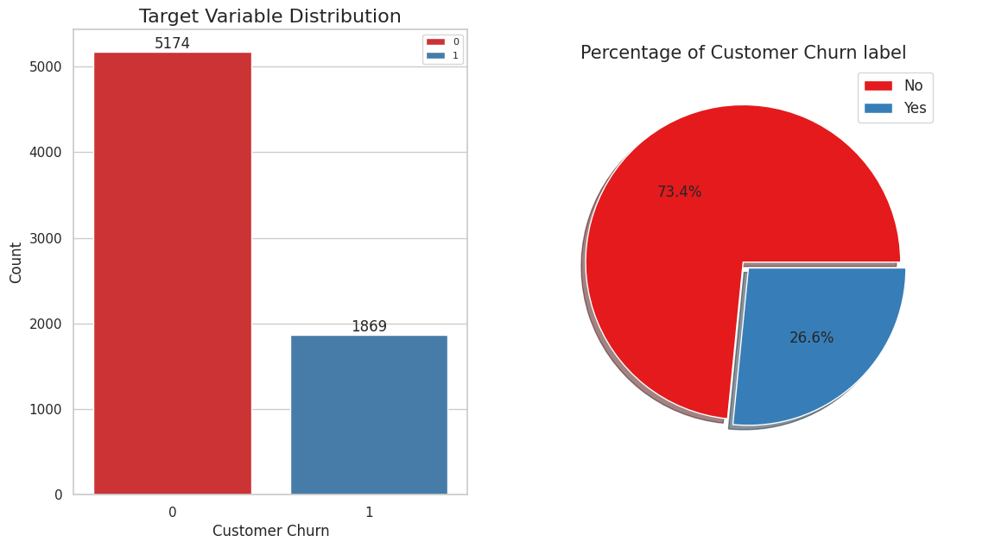


Target Variable Distribution: Churn_Label
Imbalanced Data
73.4%
26.6%

Slide 9
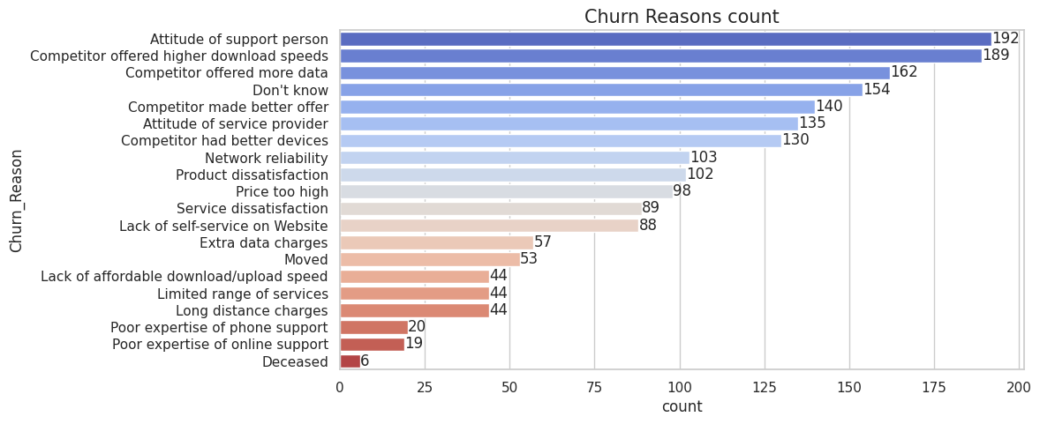


Customer Churn Reasons
Attitude of the support person and Competitor offers were the main reasons for the customer churn.

Slide 10
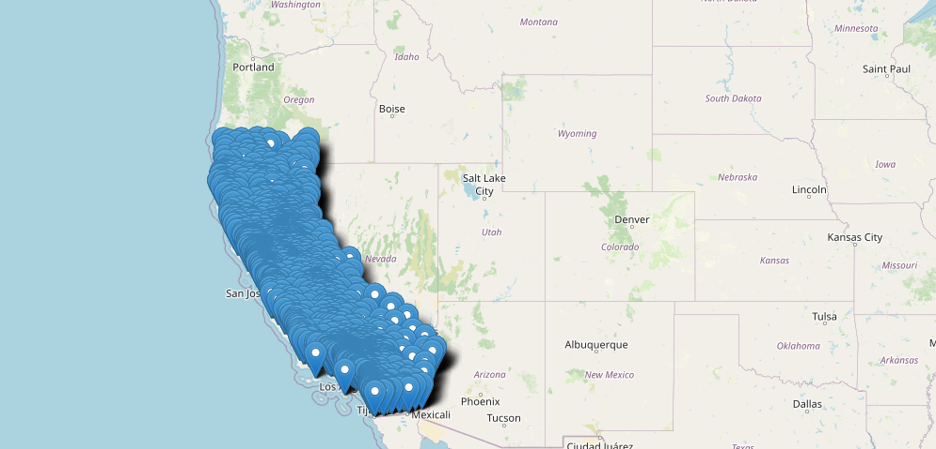
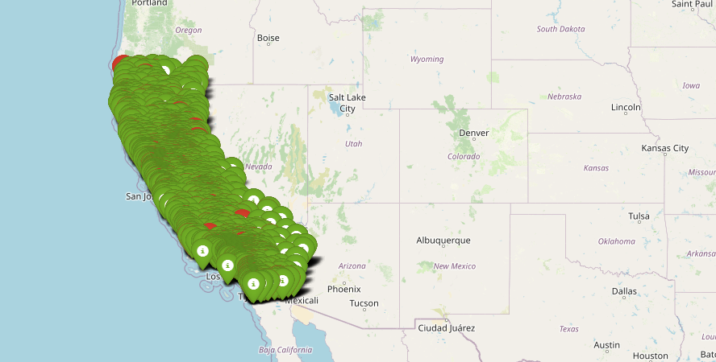
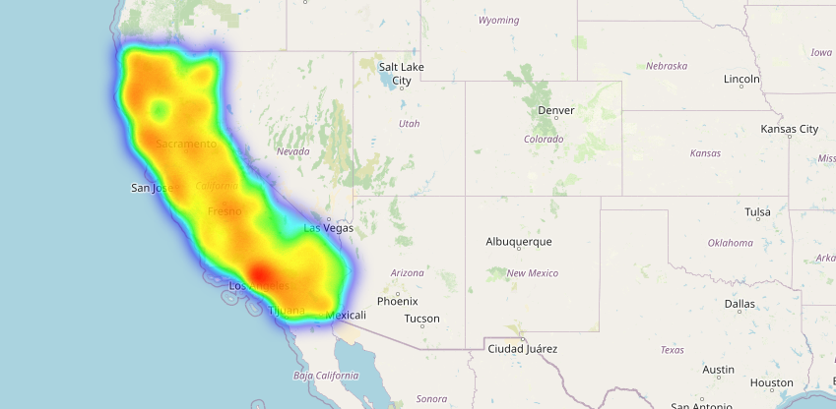
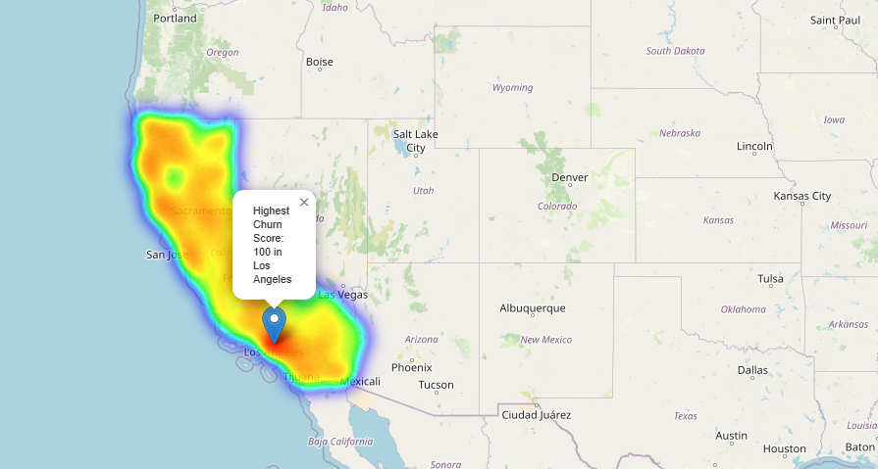
Geographical Distribution of Customer Churn
Data Distribution
Churn values Distribution
Monthly Charges Distribution
Churn Score Distribution

Slide 11
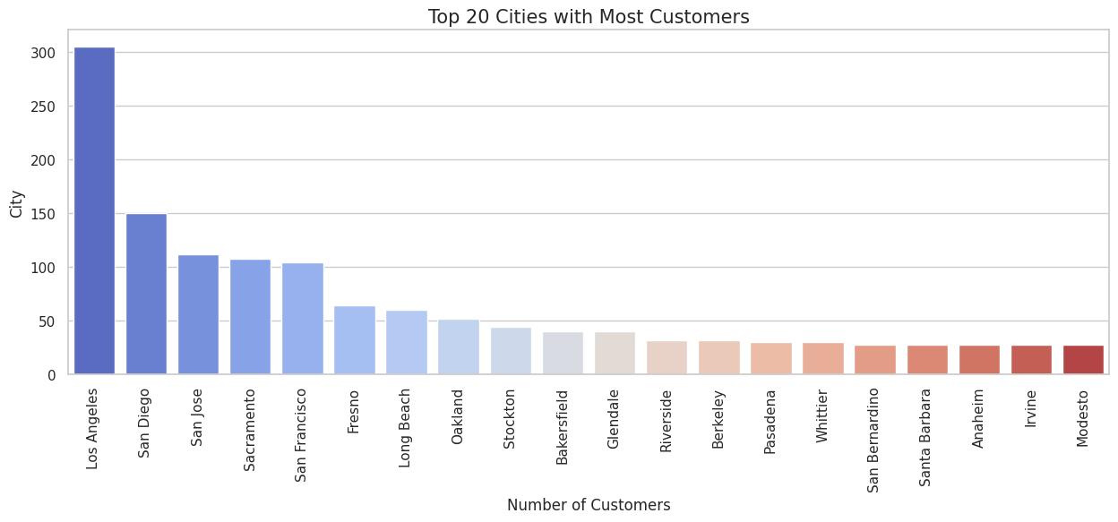
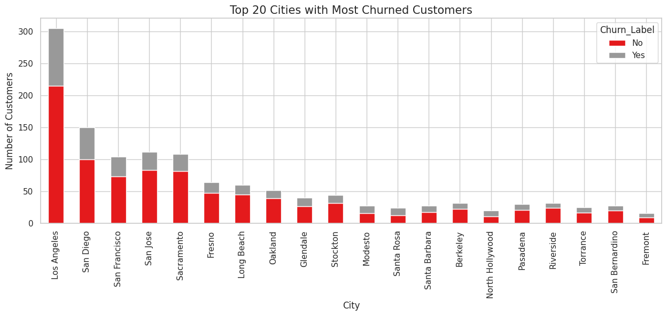

Distribution of Customer Churn by City
Los Angeles, San Diego, San Francisco, San Jose, Fresno, Long Beach and Oakland have the highest customers and hence the churn values are also high.

Slide 12
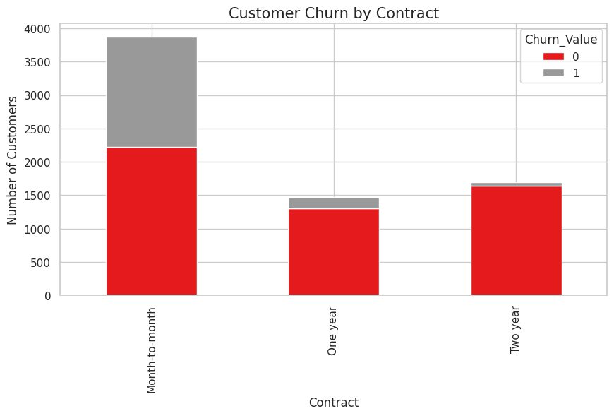
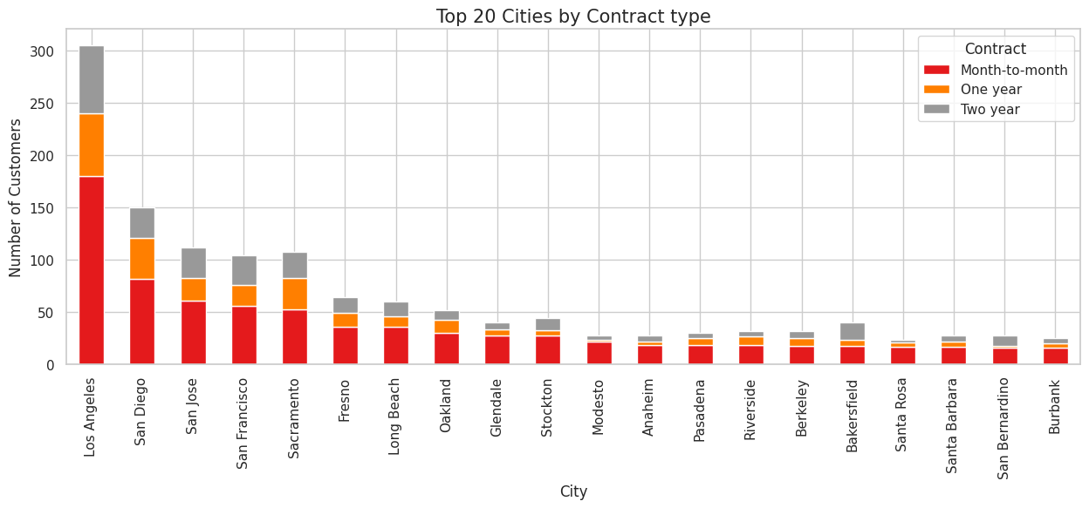
Distribution of Customer churn by Contract type across Cities
Los Angeles, San Diego, San Francisco, San Jose, Fresno, Long Beach and Oakland have the highest Monthly contracts, followed by one-year contracts and two-year contracts.

Slide 13
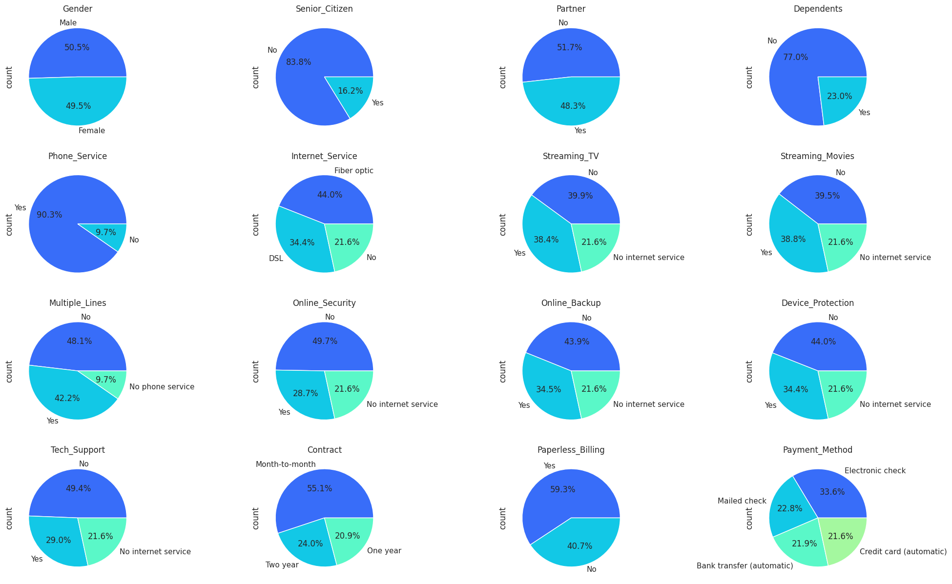

Distribution of Products and Services
Equal Distribution of Gender
Few Senior Citizens
Low Dependents
High Month to month contracts
High subscription for Phone Service
High subscription for Multiple lines
Higher Fiber optic customers
High paperless billing preference

Slide 14
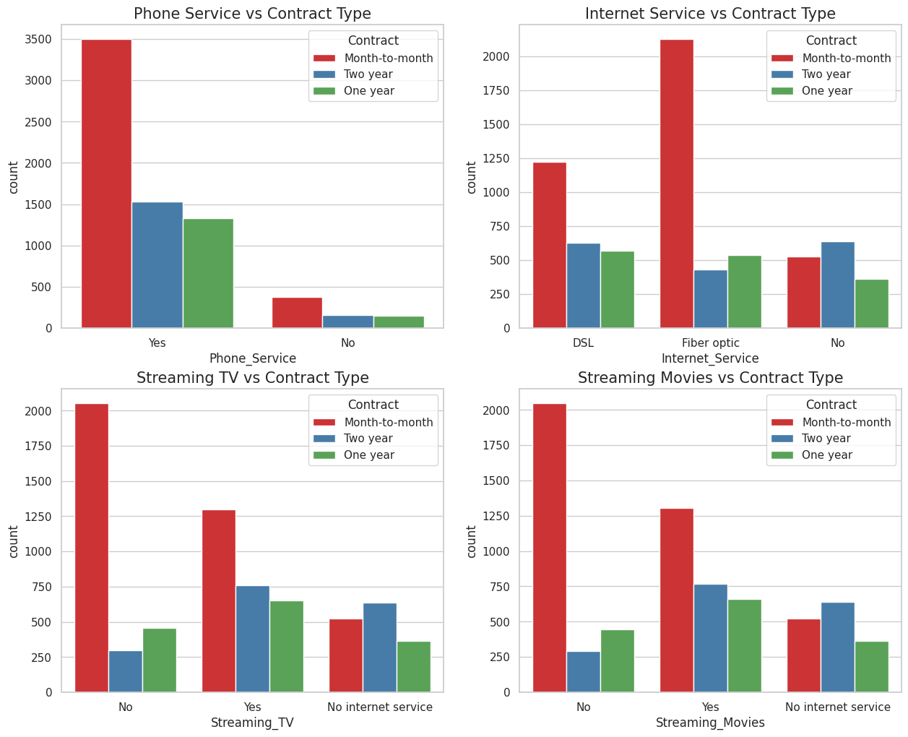
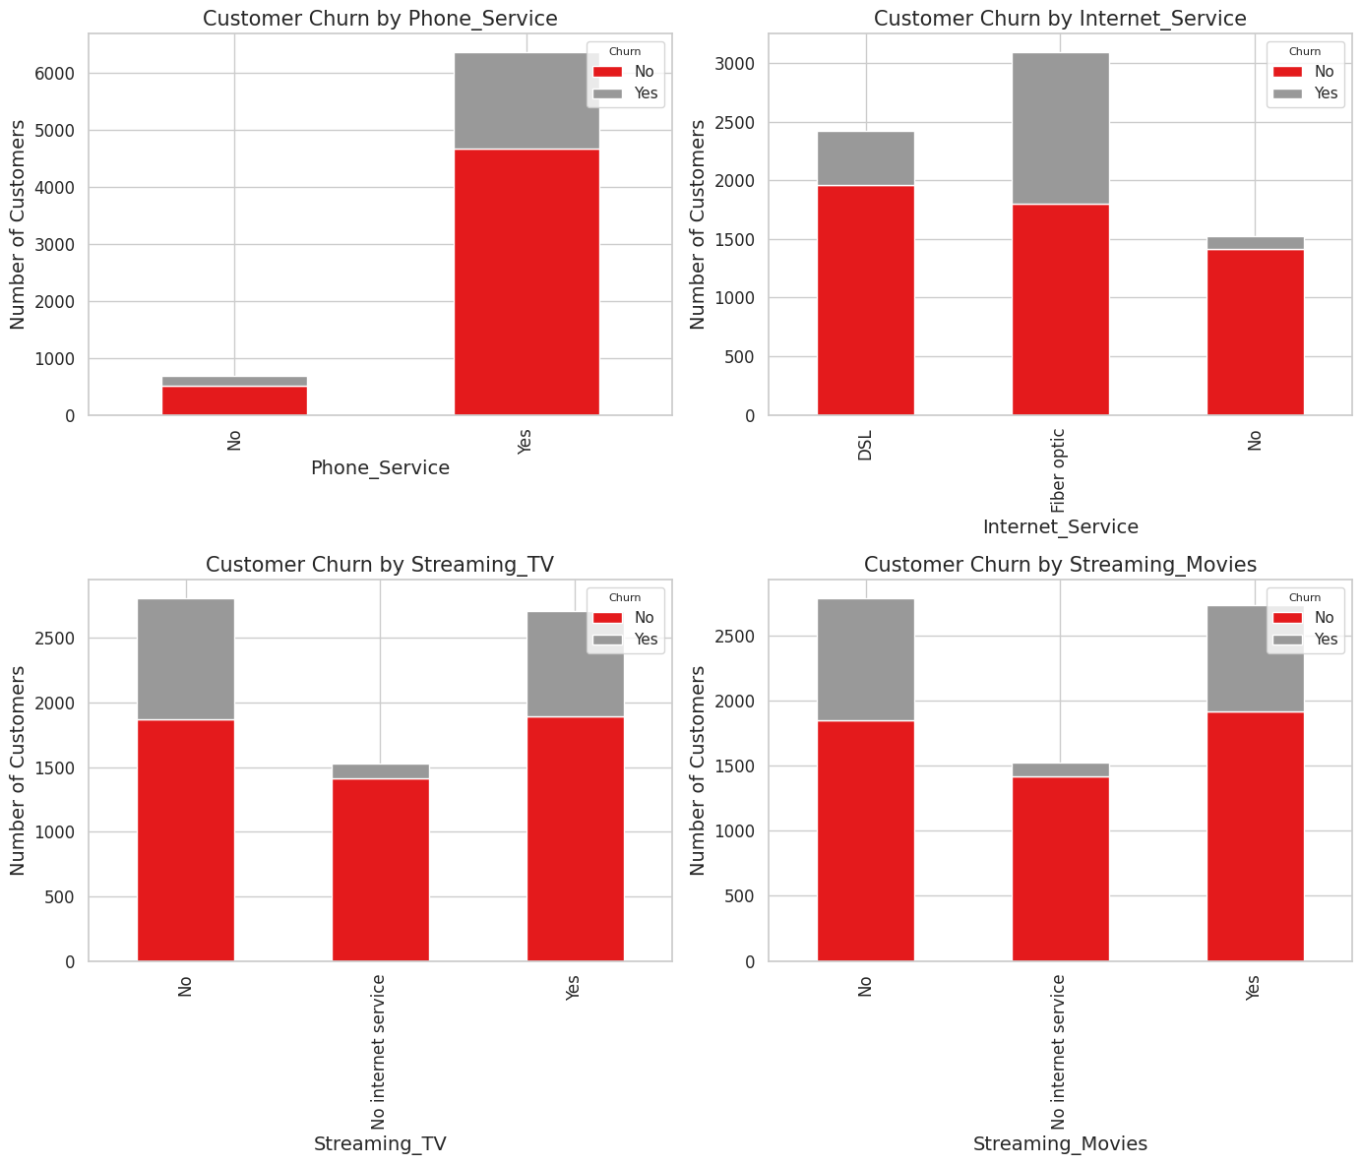
Distribution of Products by Contracts & Customer churn
Month-to-month contracts are most popular across all categories of Phone, Internet, TV streaming and Movie Streaming Services.
Phone services, TV streaming and Movie streaming show less customer churn whereas Internet service shows high churn for Fiber optic service.

Slide 15
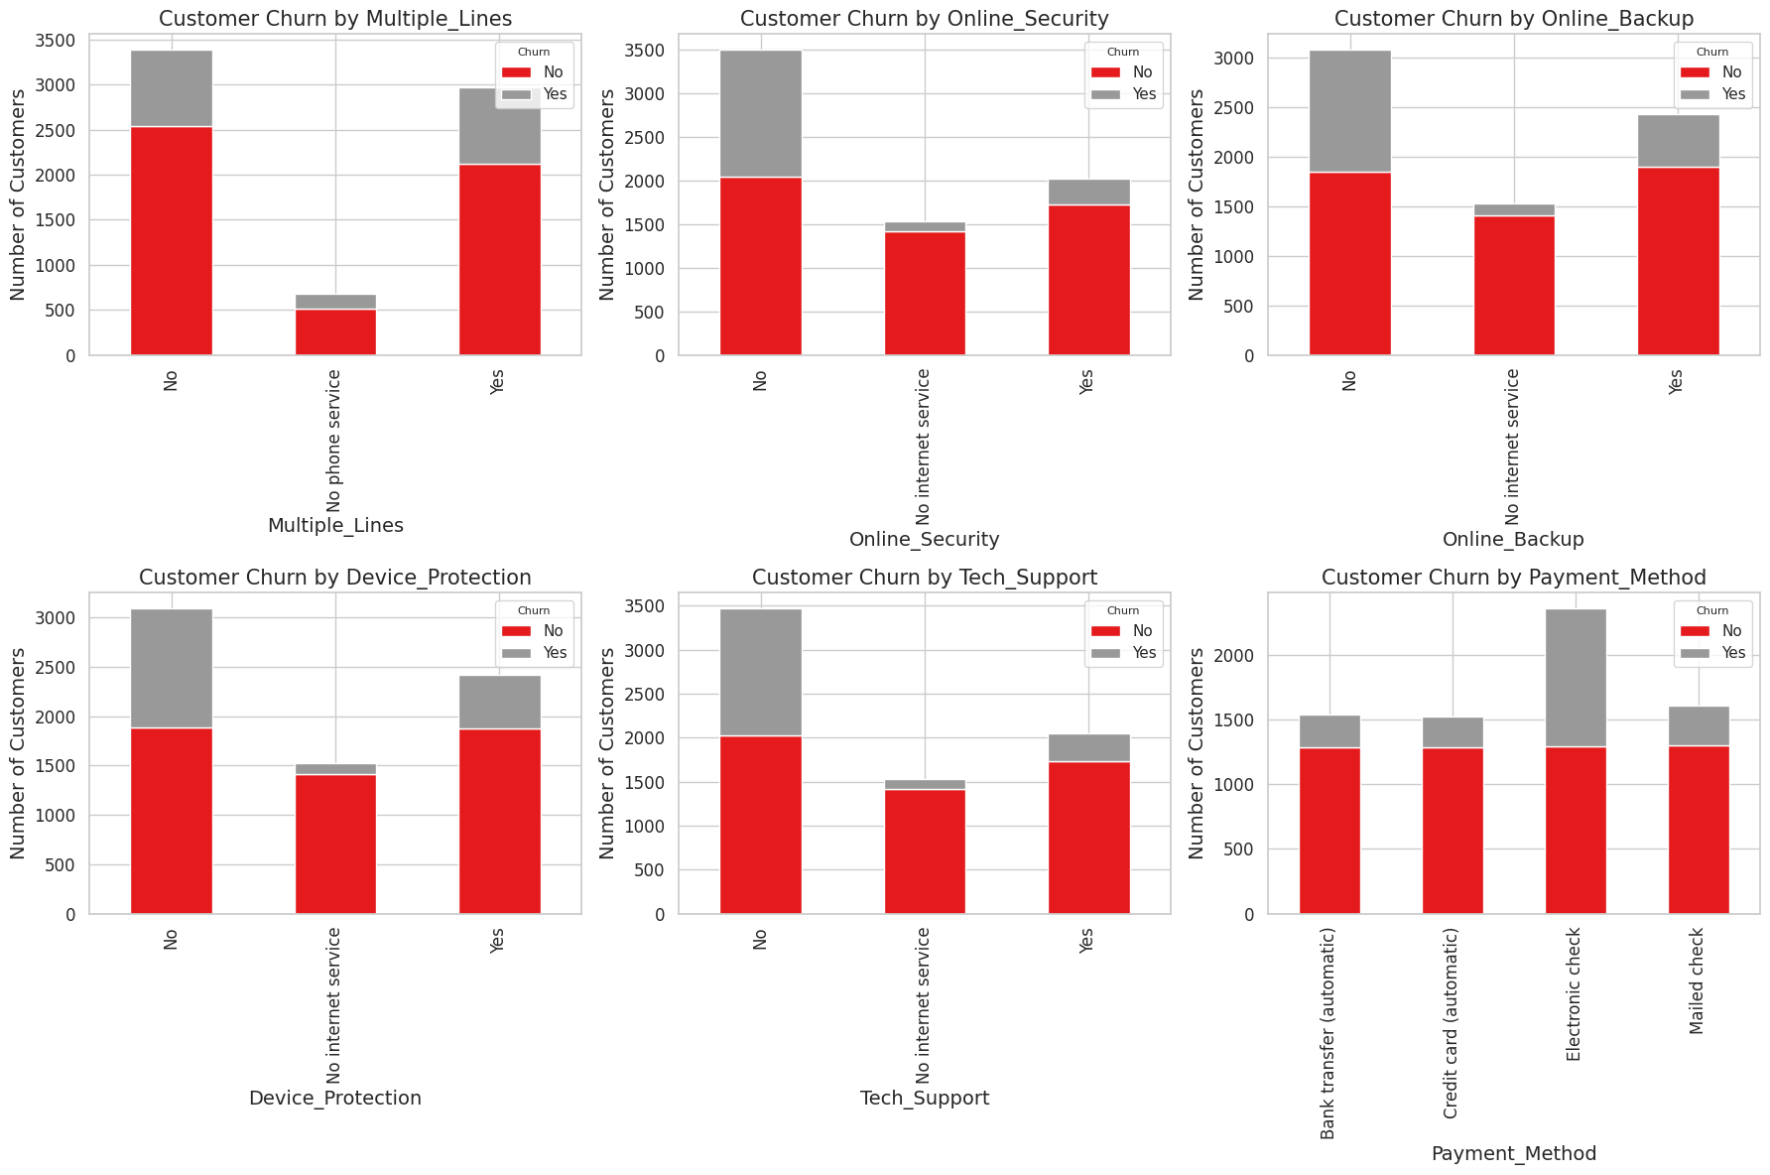

Distribution of Services by Customer churn
Customers prefer the Multiple lines, Online security, Online backup, Device protection, Tech support services and have very low churn value. Only the Electronic checks payment method has a high churn value.

Slide 16
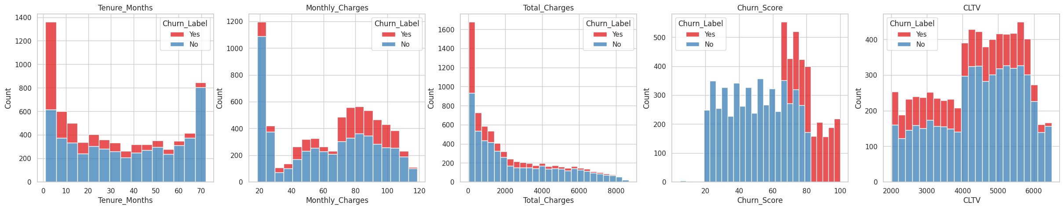
Distribution of Continuous Customer Attributes
Customer churn is high for less than 1 year contract, and it decreases after that.
Customer churn increases for higher monthly charges.
Customer churn is high for lesser total charges and decreases after that.
Churn score is higher for a score 65 and above.
Churn values are equal across all the Customer lifetime values.

Slide 17
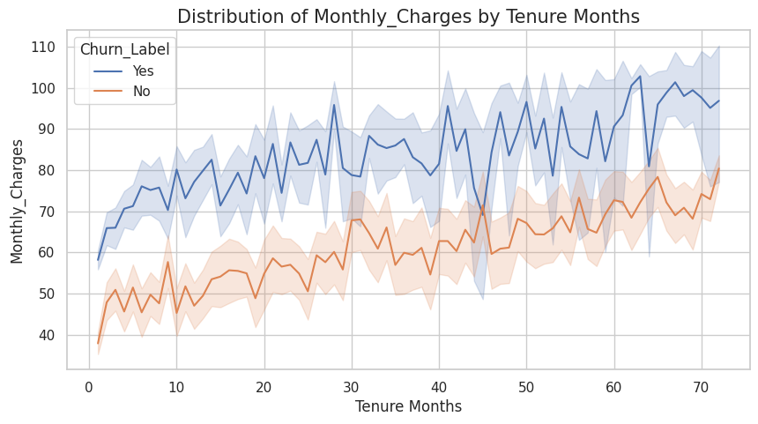
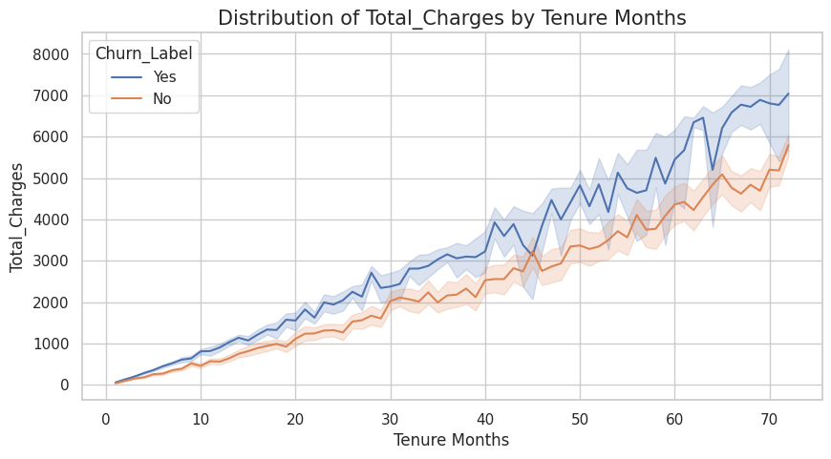
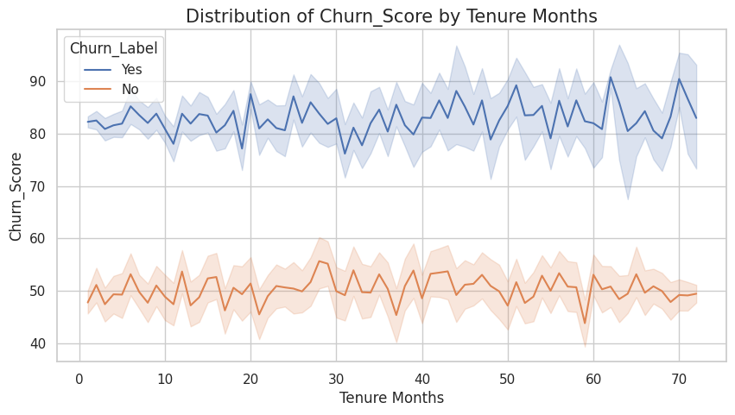
Customer Attribute Trends across Tenure Months
Monthly charges increases with the tenure months.
Total charges increases with increase in tenure months.
Churn score is around 45-55 for no-churn customers whereas it is around 80-100 for customers who churn.

Slide 18
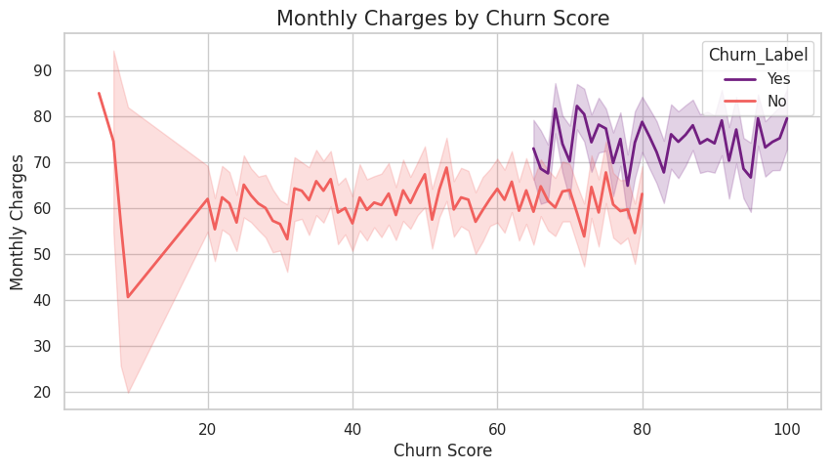
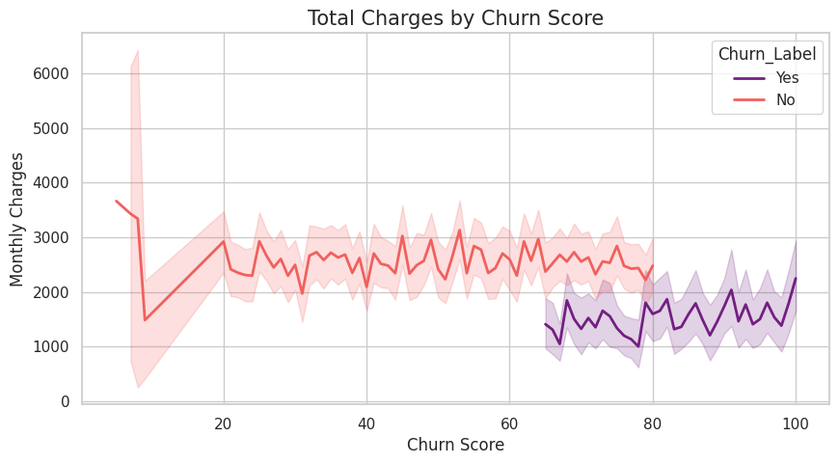

Customer Charges by Churn Score
Customers churn score increases beyond Monthly charges between $60-70.
Customer churn score is higher when Total charges between $1000 - 2000.

Slide 19
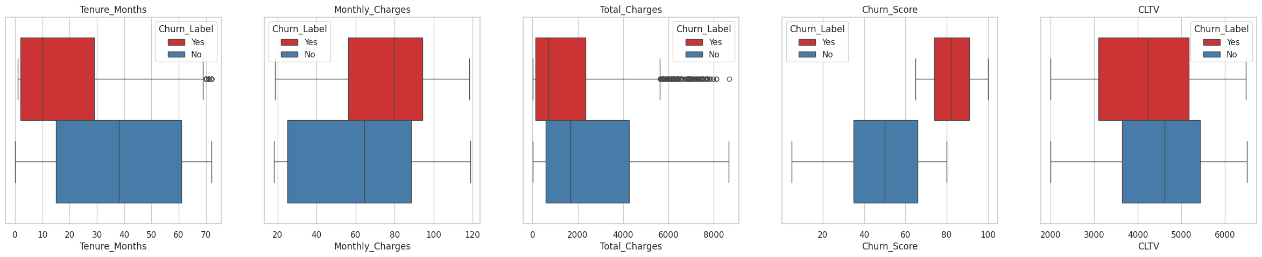
Box plots for outlier detection
There are very few outliers for the Tenure months and the Total charges features.
We will keep these data points to utilize the information for customer behavior from these data points.

Slide 20
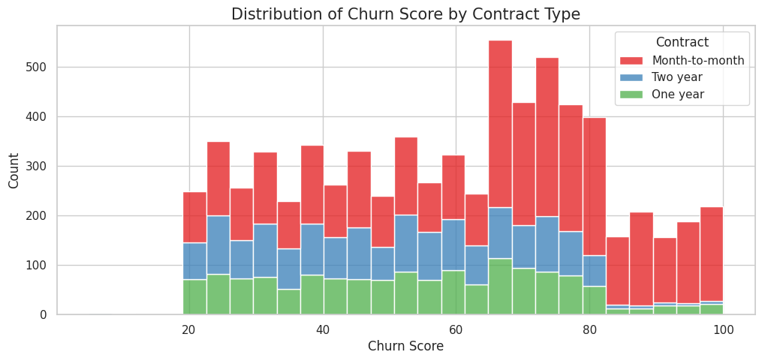
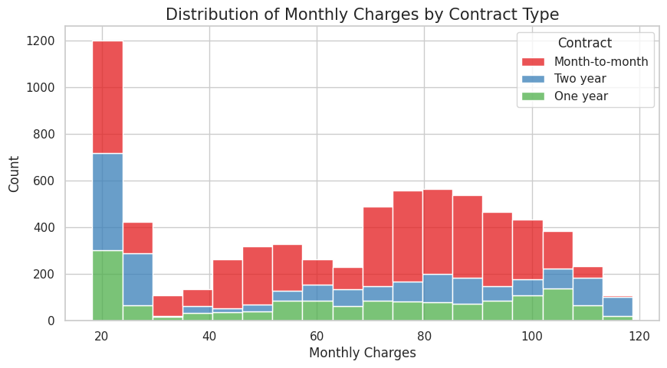
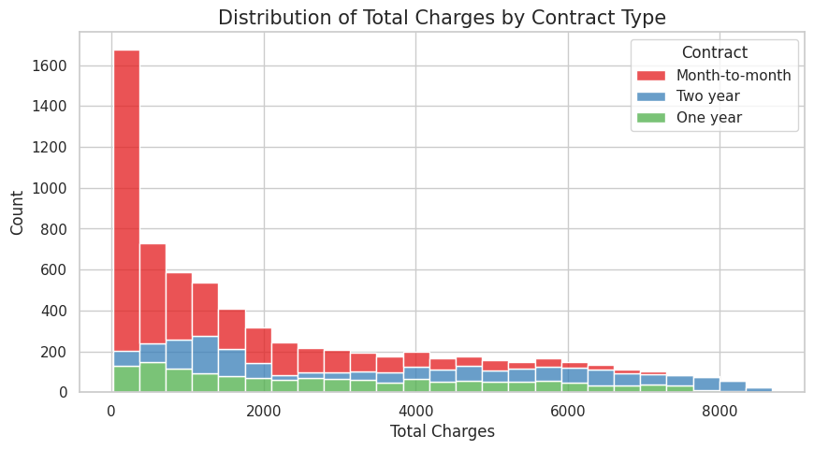

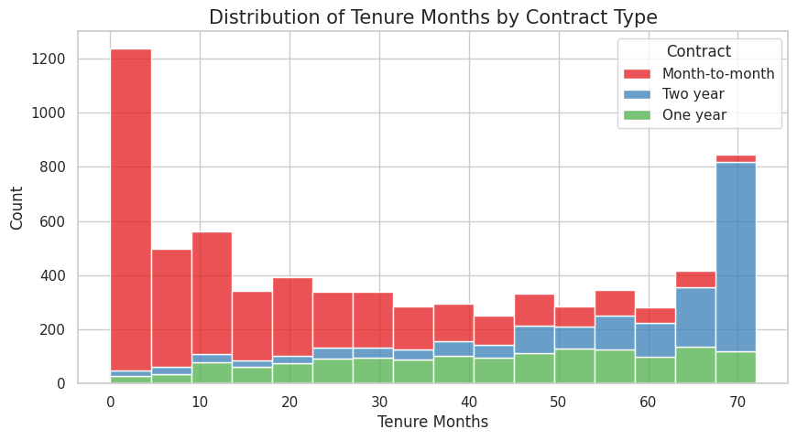
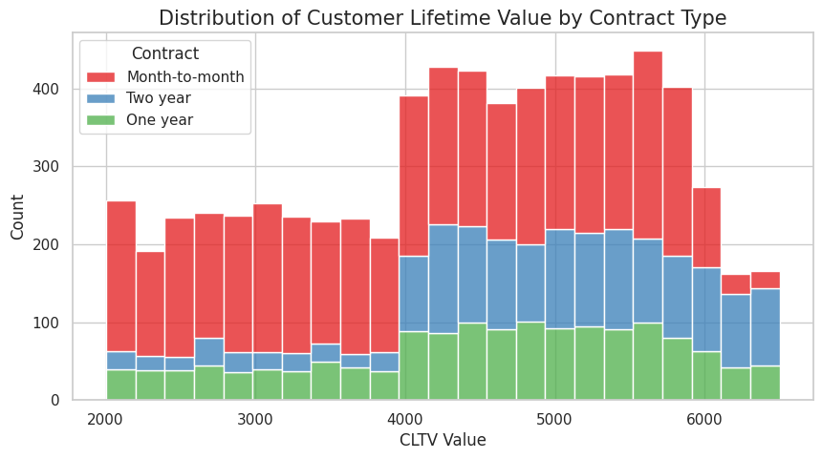
Distribution of Numerical Attributes by Contracts
The month-to-month contract type has the highest value across all continuous customer attributes across all contract types as the customer’s preferred product followed by Two-year plans and One-year plans.

Slide 21
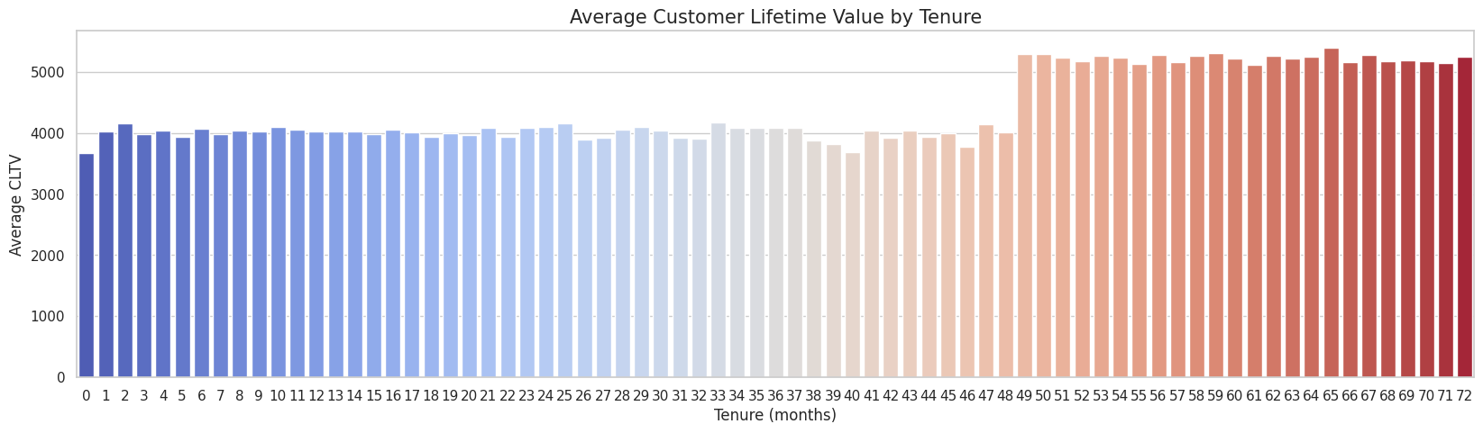

Average Customer Lifetime Value with Tenure months
The Customer Lifetime value is constant around 4000 for the first 48 months and then it suddenly increases to around 5000 beyond the 48 months.

Slide 22
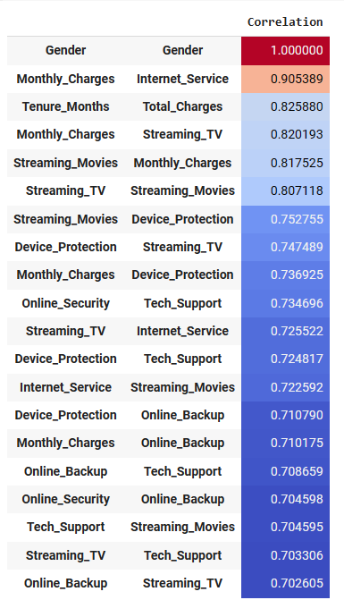
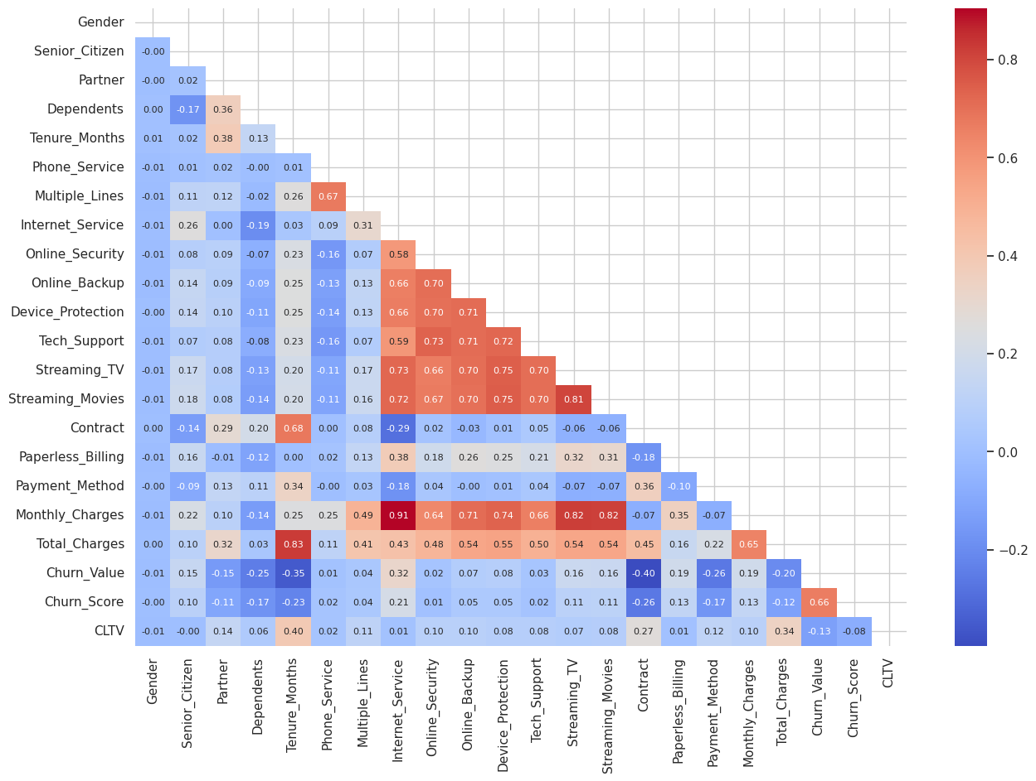
Correlation Heatmap
Many of the products and services show high correlation which shows the customer’s tendency to bundle products and services.

Slide 23
Machine Learning

Slide 24
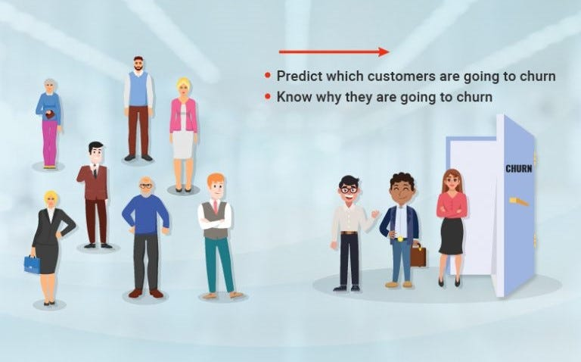

Churn Prediction with Machine Learning

Slide 25

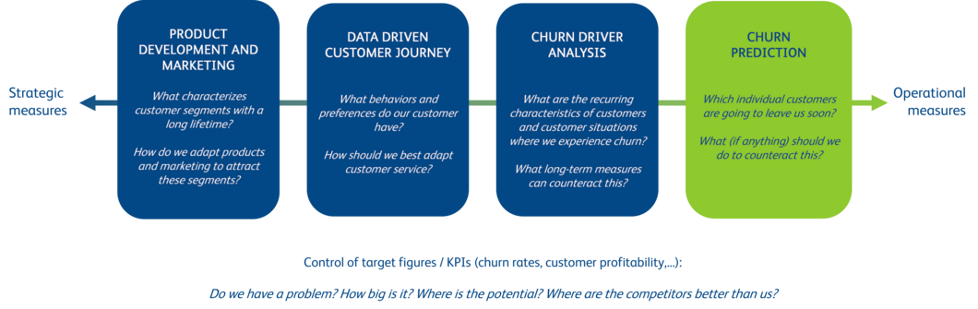
Machine learning & Churn Management
Machine Learning
Product pricing strategy
https://www.bearingpoint.com/en-no/insights-events/blog/tips-for-predicting-and-preventing-churn/

Slide 26
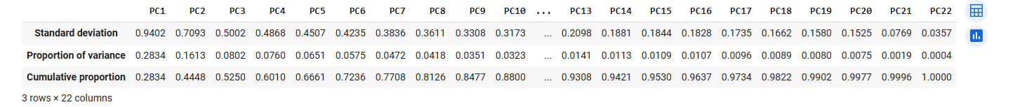
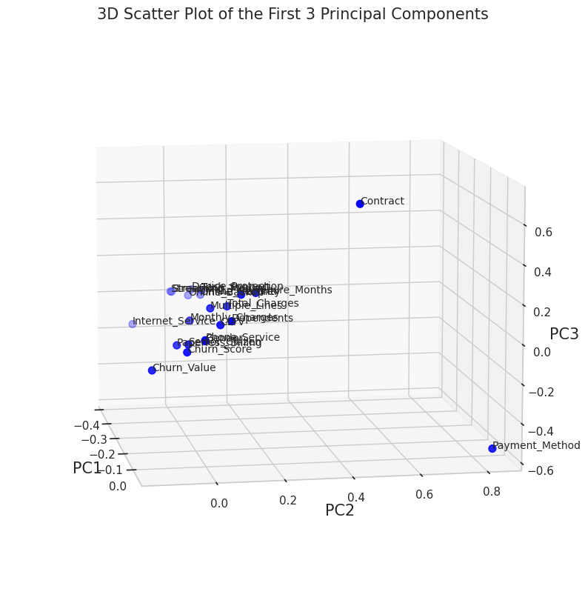
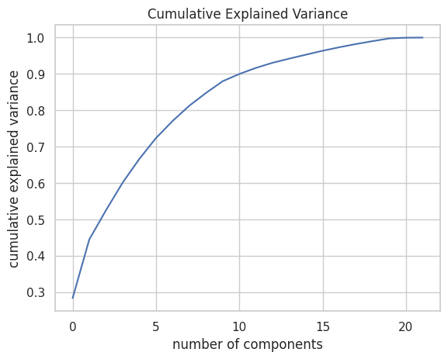
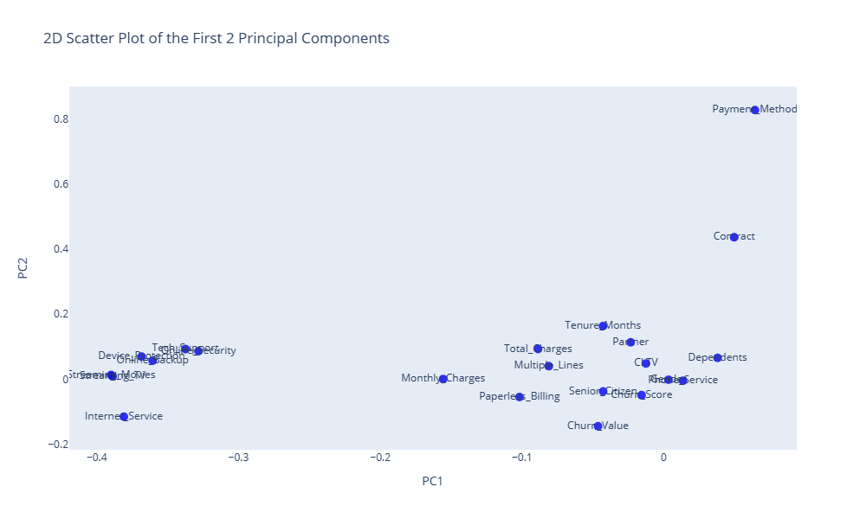
PCA – Dimensionality Reduction
n_Components = 21

Slide 27
Model Fitting
Classification Models
Preprocessing
Logistic Regression
XG Boost
Decision Trees
Random Forest
KNN
ADA Boost
CAT Boost
Feature Encoding
Min-max scaling
PCA
Train Test Split

Slide 28
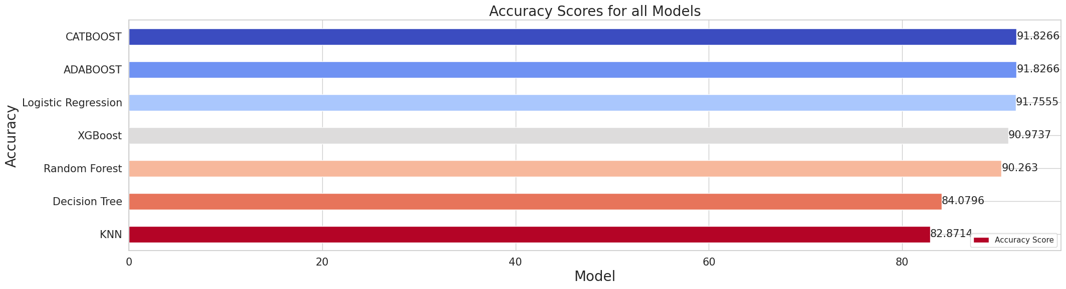
Model Performance
CATBoost and ADABoost models have the highest accuracies followed by Logistic Regression.

Slide 29
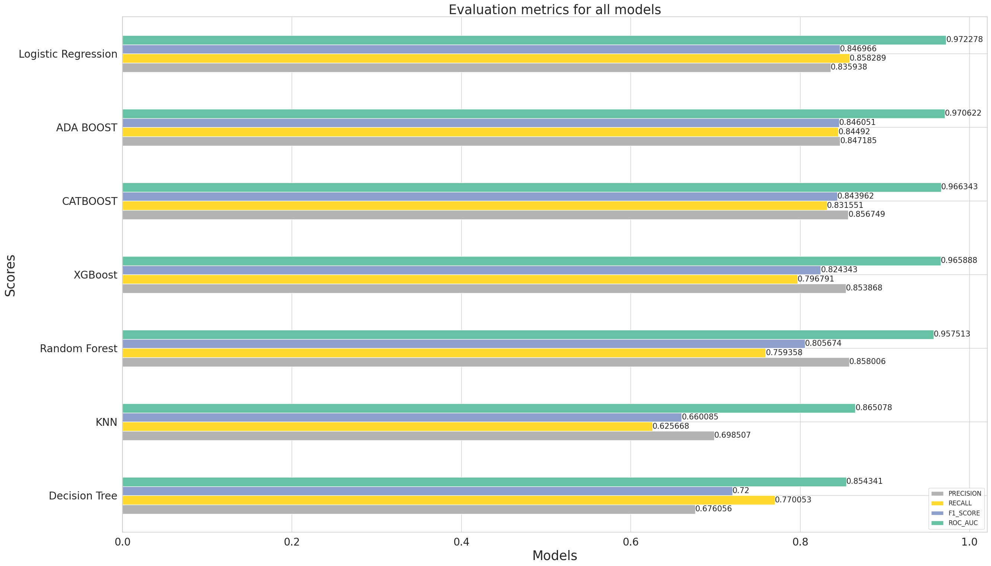
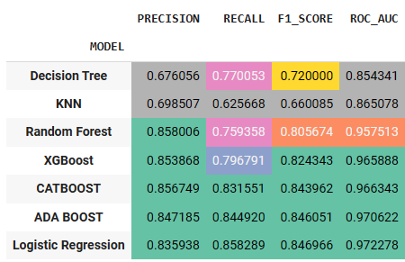
Model Evaluation Metrics

Slide 30
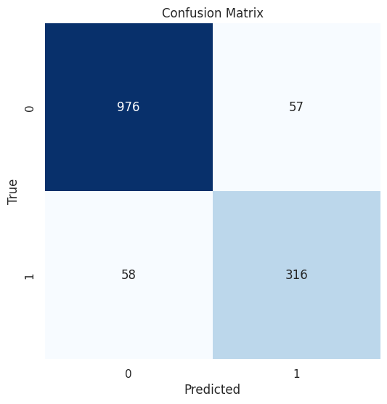
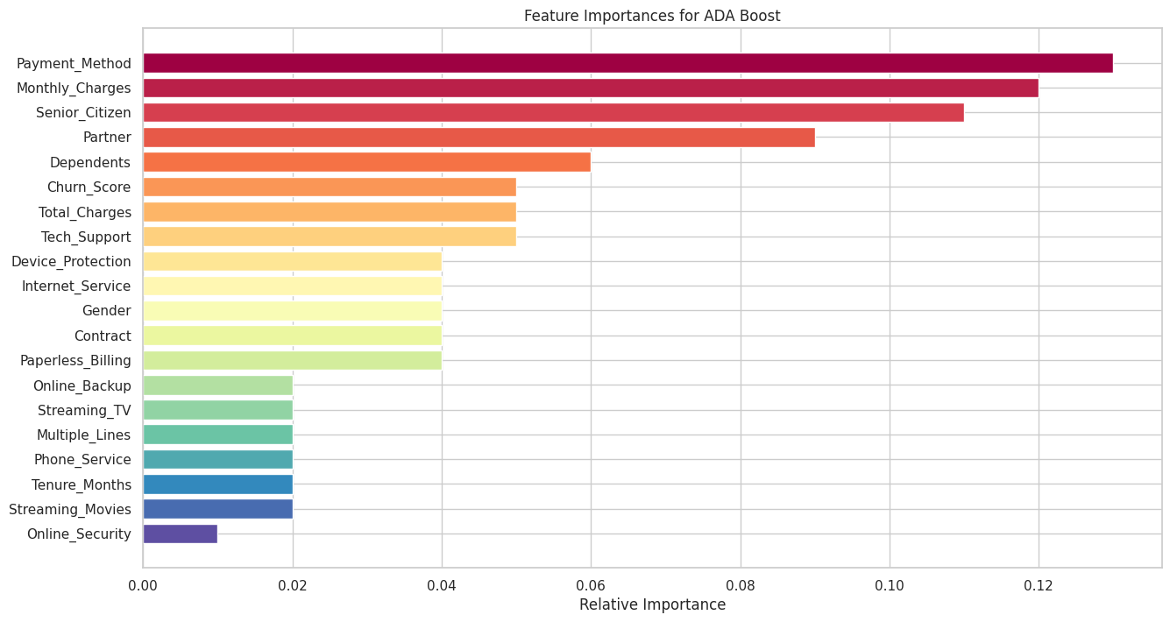
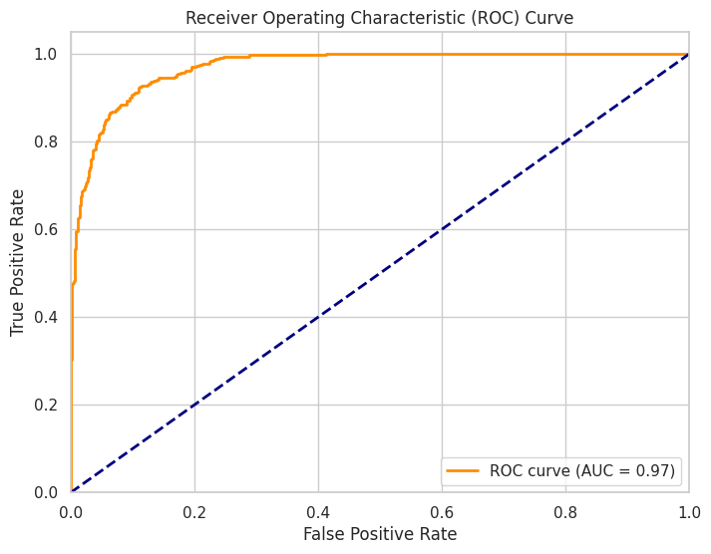
Feature Importances with ADA Boost
Accuracy = 0.9182658137882018 Precision: 0.8471849865951743 Recall: 0.8449197860962567 F1 Score: 0.8460508701472558
ROC Area under Curve = 0.8948703480336075

Slide 31
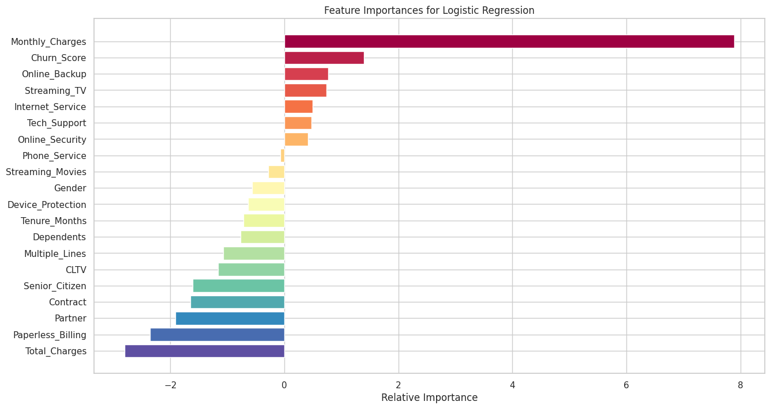
Logistic Regression Feature Importances
A positive coefficient means that an increase in the feature value will increase the log odds of the positive class, making it more likely.
Accuracy:0.9175550817341862 Precision: 0.8359375 Recall: 0.8582887700534759 F1 Score: 0.8469656992084431
ROC Area under Curve: 0.8986506773791098
A negative coefficient means that an increase in the feature value will decrease the log odds of the positive class, making it less likely.
How To Get Feature Importance In Logistic Regression | Forecastegy

Slide 32
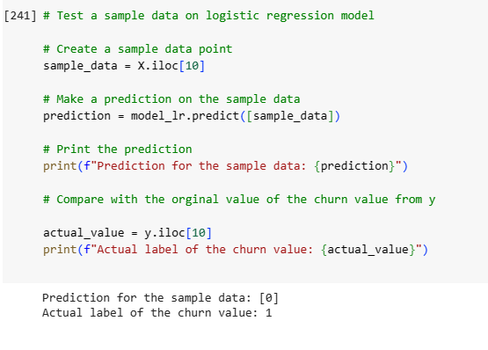
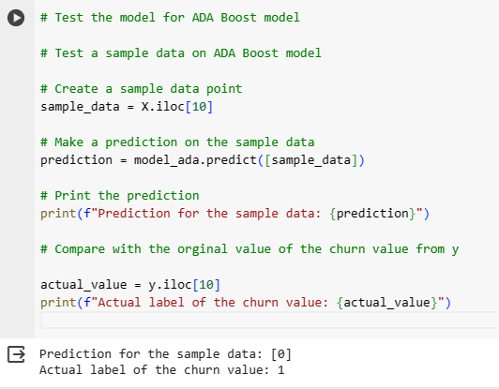
Model testing on sample data
Logistic Regression
ADA Boost

Slide 33
K-Fold Cross Validation

Slide 34
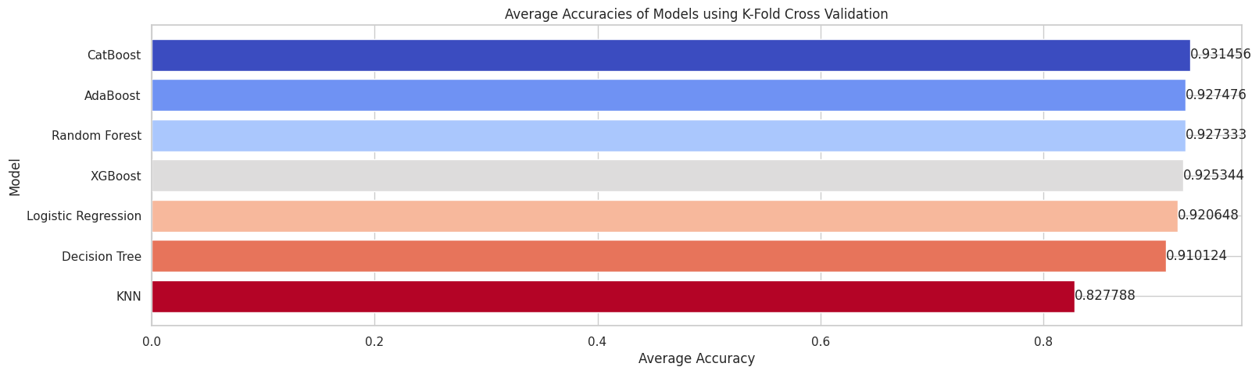
Model Comparison

Slide 35
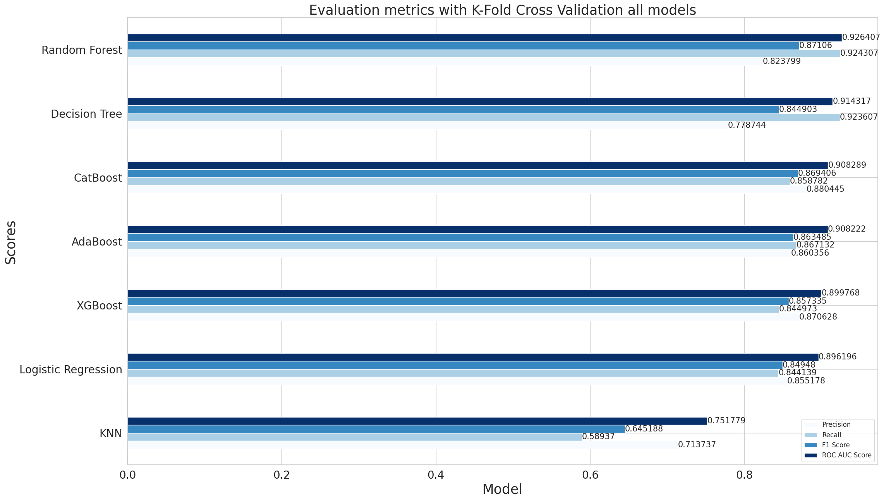
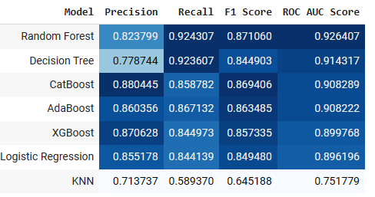
Evaluation metrics K-fold cross validation

Slide 36



Best model: Random Forest (Recall Score & ROC AUC Score)
Average Accuracy: 0.9273328541199712
Average Precision: 0.8237988209809695
Average Recall: 0.9243067611447424
Average F1 Score: 0.8710603165192733
Average ROC AUC Score: 0.9264066049150225

Slide 37

Testing the Random Forest K-fold model on sample data

Slide 38
Conclusions

Slide 42

Suggestions

Slide 43

Questions?

Slide 44

Thank you!

Slide 45

Appendix

Slide 46
Data Dictionary
CustomerID | A unique ID that identifies each customer.
Count | A value used in reporting/dashboarding to sum up the number of customers in a filtered set.
Country | The country of the customer's primary residence.
State | The state of the customer's primary residence.
City | The city of the customer's primary residence.
Zip Code | The zip code of the customer's primary residence.
Lat Long | The combined latitude and longitude of the customer's primary residence.
Latitude | The latitude of the customer's primary residence.
Longitude | The longitude of the customer's primary residence.
Gender | The customer's gender
Senior Citizen | Male, Female
Partner | Yes, No
Dependents | Yes, No
Tenure Months | Yes, No.
Phone Service | Yes, No
Multiple Lines | Yes, No
Internet Service | No, DSL, Fiber Optic, Cable.
Online Security | Yes, No
Online Backup | Yes, No
Device Protection | Yes, No
Tech Support | Yes, No
Streaming TV | Yes, No.
Streaming Movies | Yes, No.
Contract | Month-to-Month, One Year, Two Year.
Paperless Billing | Yes, No
Payment Method | Bank Withdrawal, Credit Card, Mailed Check
Monthly Charge | Charge per month
Total Charges | Charges per quarter
Churn Label | Yes, No
Churn Value | 1,0
Churn Score | A value from 0-100
CLTV | Customer Lifetime Value.
Churn Reason | Reason for exit

Slide 47


Customer Churn patterns by charges across contracts
Customer churn is higher when the monthly charges and total charges are higher.
The company needs better customer service to advise customers on value-oriented plans for customer loyalty and retention.

Slide 48


Slide 49

Decision Tree visualization with max_depth=4

Slide 50

XGBoost Plot

